Slide 1
Performance modelling of skewed demand in complex systems
Stephen Shephard
School of Computing Science, Newcastle University, Newcastle upon Tyne, NE1 7RU
s.shephard2@newcastle.ac.uk

Slide 2
Introduction
On-line Transaction Processing applications often have skewed demand for some resources
Overloading the whole system affects:
- reputation
- revenue
Cloud technologies may maintain throughput to low demand resources

Slide 3
Motivation
High profile total outages with skewed demand
- London 2012 Olympic tickets website
- HBO Go “True Detective” finale
- Apple iTunes iPhone 7 launch
Notes:
Real world examples of skewed demand

Slide 4
Outline
Background Information – Use Case
Technologies
Modelling
Methods
Systems
Results
Conclusions & Future Work

Slide 5
Background Information
Use Case: multi-tier ticketing
Web Server 1
Worker
Data
Application 1
Node 1
Web Server 2
Worker
Data
HTTP Load
Application 2
Node 2
Balancer
Middleware
DB Engine
...
...
...
Web Server
Worker
Data
m
Application
n
Node
p
Notes:
Multi-sport event ticketing application using a distributed architecture. Users access the application with a web-based front end. Tickets are stored in one or more databases. In between the web servers and database are worker applications that service user requests, connected to the web servers by some middleware.
It is assumed that there will be predictable skewed demand for athletics tickets, and a constant ‘normal’ demand for cycling etc.

Slide 6
Technologies
Adapting to demand
Elastic scaling
Sharing demand
Content-blind HTTP load-balancing
Shared middleware
Isolating demand
Content-aware HTTP load balancing
Distributed databases
Microservices

Slide 7
Middleware
Decouple web server/worker application demand
Web Server 1
Worker
Application 1
Web Server 2
Point
-
to
-
Worker
point Queue
Application 2
...
...
Web Server
Worker
m
Application
n

Slide 8
Distributed Databases
Athletics
Archery
Cycling
Judo
Diving
Fencing

Slide 9
Distributed Databases
Athletics
Archery
Archery
Cycling
Judo
Athletics
Judo
Diving
Fencing
Cycling
Fencing
Diving

Slide 10
Microservices
Isolate demand from worker to data node
Web Server 1
Search
Web Server 1
REST API
Search
DB
e
Web Server 2
n
Web Server 2
a
HTTP Load
Book
l
Book
p
k
Balancer
DB
c
a
B
...
...
Web Server
Web Server
Return
Return
m
m
DB

Slide 11
Modelling
Why model?
- Demand is moved, not eliminated
- How do demand manipulations combine?
- Where do the bottlenecks move to?
Models make predictions for complex systems

Slide 12
PEPA
Performance Evaluation Process Algebra

Slide 13
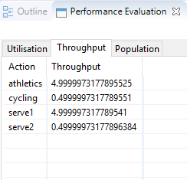
PEPA Eclipse plugin
a = 10.0; /* Athletics arrival rate */
c = 1.0; /* Cycling arrival rate */
s1 = 5.0; /* Service rate 1 */
s2 = 5.0; /* Service rate 2 */
Arrival_A = (athletics, a).Arrival_A;
Arrival_C = (cycling, c).Arrival_C;
Service_1 = (serve1, s1).Service_1;
Service_2 = (serve2, s2).Service_2;
Q_0 = (athletics, T).Q_1 + (cycling, T).Q_2;
Q_1 = (serve1, T).Q_0;
Q_2 = (serve2, T).Q_0;
Arrival_A <athletics> Q_0[20] <serve1> Service_1 <cycling> Arrival_C <serve2> Service_2

Slide 14
Methods
Produce simple technology component models in PEPA
Compose into system models
Simple Microservices
Shared Queue and Distributed Database
Shared Queue and Distributed Database with Replication
Experiment with models using PEPA Eclipse plugin
Test model results against actual built systems

Slide 15
Testing
Build systems in Microsoft Azure cloud
Java and Java Spring
Cassandra Database
Microsoft Azure Storage Queues
Instrument the systems using CodaHale Metrics
Counts every request, takes a 1-minute rolling average every 10s
Test and measure each system 5 times and average the results
Simulate skewed demand with Apache JMeter test plans

Slide 16
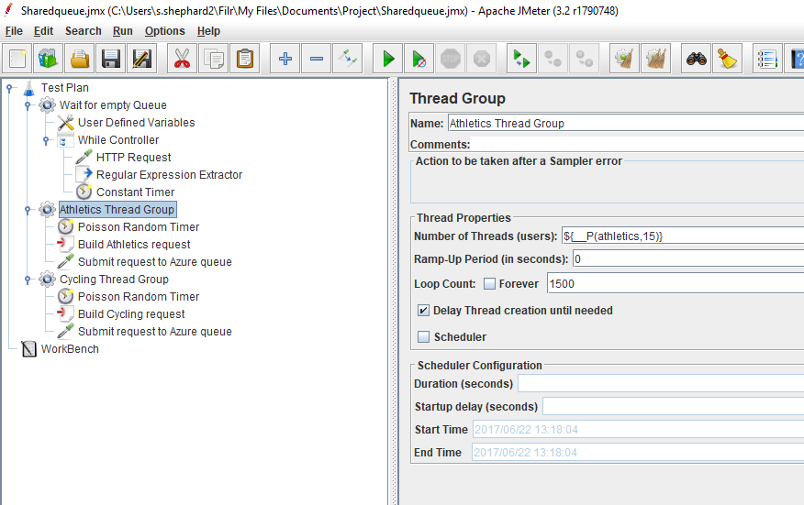
Testing
Apache JMeter test plan

Slide 17
Systems
Simple microservices
Notes:
Separate end-to-end services for handling athletics and cycling ticket requests. This is not a `natural' microservices implementation, which would be more likely to separate on operations e.g. searching, booking and returning tickets, but it is comparable to the distributed database models.
The system has two separate databases, one for athletics tickets, one for cycling, and each has its own dedicated worker application.

Slide 18
Systems
Shared Queue and Distributed Database

Slide 19
Systems
Shared Queue and Distributed Database with Replication

Slide 20
System Model
Shared Queue and Distributed Database
(animation of PEPA model, Eclipse version, composing queue and distributed DB?)

Slide 21
Results (model vs built)
Demand | Athletics | Cycling | Ratio
1 | 1 | 1 | 1
2 | 2 | 1 | 2
3 | 3 | 1 | 3
4 | 4 | 1 | 4
5 | 5 | 1 | 5
6 | 5.98 | 1 | 6
7 | 6.93 | 0.99 | 7
8 | 7.76 | 0.97 | 8
9 | 8.4 | 0.93 | 9
10 | 8.83 | 0.88 | 10
Demand | Athletics | Cycling | Ratio
1 | 1 | 1 | 1
2 | 1.96 | 1.02 | 1.92
3 | 3 | 1.02 | 2.94
4 | 3.38 | 1.02 | 3.32
5 | 3.51 | 0.85 | 4.13
6 | 3.61 | 0.7 | 5.14
7 | 3.71 | 0.6 | 6.14
8 | 3.72 | 0.53 | 6.97
9 | 3.7 | 0.46 | 7.98
10 | 3.77 | 0.41 | 9.11
Notes:
Results for queue and distributed DB with replication, model vs built system (built system results scaled down). Model is on the left. Cycling demand is at a constant rate of 1, the ratio is the ratio of athletics:cycling throughput.
Service rate of one data node is 5, model shows athletics demand shared between two nodes, built system shows much lower throughput. Both show cycling throughput constrained in the ratio of athletics:cycling demand in the queue (slightly less so in the built system).

Slide 22
Results (model vs built)

Slide 23
Conclusions
Successful predictions
Microservices architecture best at isolating skewed demand
Shared queue chokes cycling throughput in proportion to the relative demand between cycling and athletics
Where throughput is routed through a distributed database
When using a distributed database with replication, the overall throughput is higher than for a database without replication
Less successful predictions
Built microservices system shows athletics demand impacting cycling
Throughput not evenly spread between database nodes when using replication, not as high as expected
Notes:
The shared queue model made successful predictions even though the model's queue size is much smaller than an actual Cloud service queue.
When using a distributed database with replication, there would also be throughput at the replica node, and that therefore the overall throughput of the skewed demand resource would be higher than for a distributed database without replication.
Built microservice showing VM co-residency issues?

Slide 24
Future Work
Improved Models
System Experiments
Unknown Skewed Demand
New Models
Notes:
Improved Models – build on the abstract database model to exhibit the true behaviour more closely
System Experiments – database partitioning that shares demand, different queueing strategies
Unknown Skewed Demand – use models to adapt to emerging skewed demand e.g. flash crowds in P2P networks
New Models – publish/subscribe middleware, adapted for event streaming service for realistic microservices

